Slide 1

Microsoft Azure Service Fabric

Slide 2
Intoduction to Microsoft Azure Service fabric
Service Fabric is a distributed systems platform that makes it easy to package, deploy, and
manage scalable and reliable Microservices.
Developers and administrators can avoid complex infrastructure problems and focus on implementing mission-critical, demanding workloads that are scalable, reliable, and manageable.
Service Fabric provides platform services for hyper scale, partitioning, rolling upgrades and rollbacks, health monitoring, load balancing, replication, and failover.
Service Fabric can deploy applications either running in containers or as processes. Service Fabric is a container and process orchestrator.
Service Fabric has productive programming APIs, to help you build applications as microservices: ASP.NET Core, Reliable Actors and Reliable Services.

Slide 3
Features of Service Fabric

Slide 4
Features of Microsoft Azure Service fabric
Microservices
Service Fabric
Container Orchestration & lifecycle management
Application Programming Models
High Availability
Hybrid Operations
Data Partitioning
Health Monitoring
Simple programming models
High Density
Rolling Upgrades
Low Latency
Placement Constraints
Replication & Failover
Fast startup & shutdown
Load balancing
Hyper-Scale
Automated Rollback
Stateful services
Windows
Server
Linux
Windows
Server
Linux
Azure
Hosted Clouds
Windows
Server
Linux
Private Clouds

Slide 5
Application Lifecycle Management
Provisioning and deployment of constituent microservices
Upgrade microservices without loss of availability
Monitor microservices
Interface with machine management layer for autoscale and initiating reboot, reimage, and repair actions
Provide operational insight into aggregate utilization – inventory, performance counters/metrics, etc. – for capacity planning

Slide 6

Upgrading Services with zero downtime
FD1/UD6
Application Package
FD0/UD0
FD1/UD5
FD0/UD1
FD2/UD4
FD2/UD3

Slide 7
Replication
Reads are completed at the primary
Writes are replicated to the write quorum of secondaries
Ack
Read
Value
Write
Ack
P
Ack
Ack
Ack
S
S
S
Write
S
Write
Write
Write

Slide 8
Reconfiguration
Types of reconfiguration
Primary failover
Removing a failed secondary
Adding recovered replica
Building a new secondary
Replica States
None
Idle Secondary
Active Secondary
Primary
X
Failed
P
S
P
B
S
S
X
Failed
S
S
Must be safe in the presence of cascading failures

Slide 9
Application: logical grouping of microservices
Application
Container
Container
Container
Container

Slide 10
Machine failure detection
Time = t₀
83
46
76
50
64
Nodes failed
Time = t₁
83
46
76
50
64
61
New Node arrived
Time = t₂
cluster reconfigured
83
46
Failures Detected
50
61

Slide 11
Microservices placement and failover
Node 100
Node 101
Node 102
Node 103
Node 104
Node 105
P
S
P
P
S
P
S
S
S
P
S
S
S
S
P
S
S
S
S
S
S
S
S
S

Slide 12
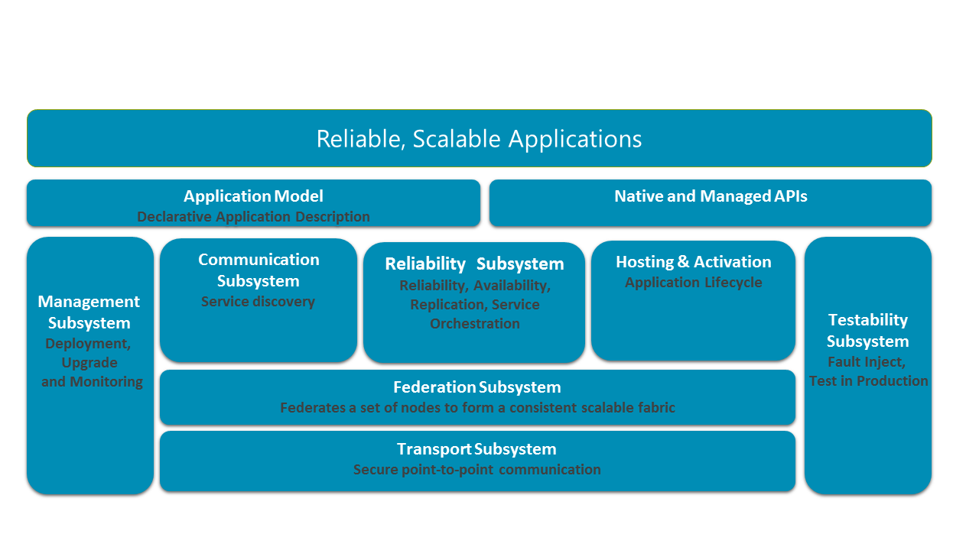
Architecture of Azure Service Fabric

Slide 13
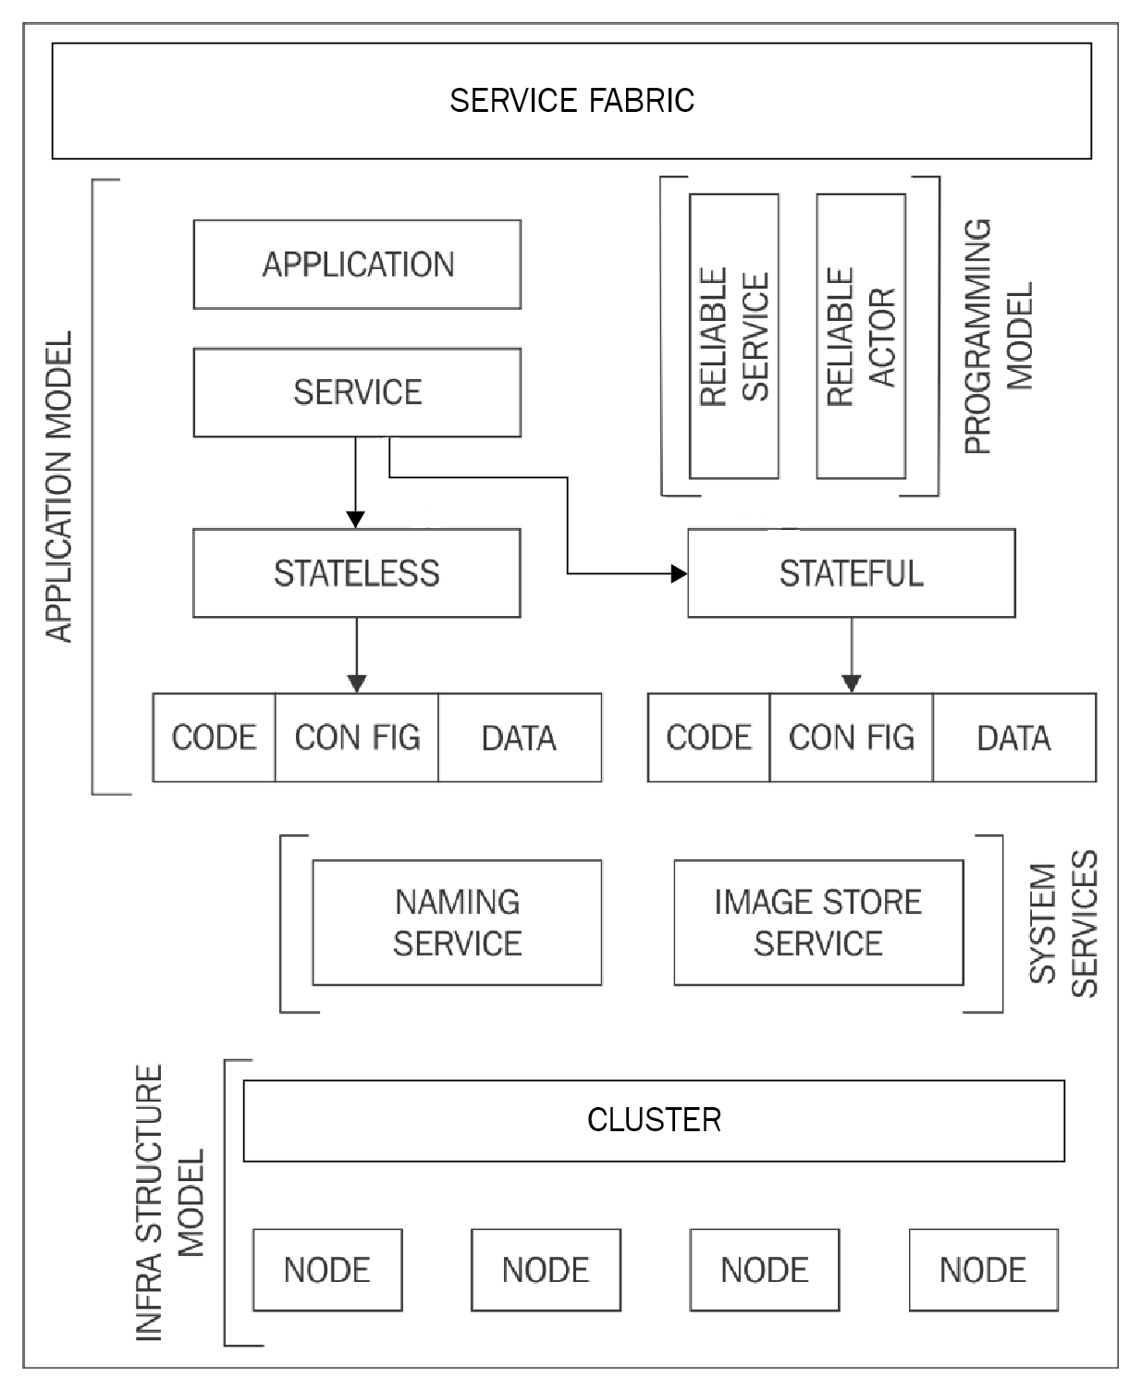
Deconstructing Service Fabric

Slide 14
Infrastructure model

Slide 15
Cluster and Nodes
Node
A set of machines that Service Fabric stitches together to form a cluster
Clusters can scale to 1000s of machines
Node
Node
Node
Node
Node is a machine or VM that is part of a cluster
Node

Slide 16
System services

Slide 17

Naming service
A client can securely communicate with any node in the cluster using the naming service to resolve a service name and its location.
The naming service responds with the actual machine IP address and port where it is currently running.

Slide 18

Image store service
The application package files are versioned and copied to Service Fabric cluster's image store. The image store is made available to the cluster and other services through a hosted service called the image store service.

Slide 19

Failover manager service
When a node fails or when a node is added to the cluster, the failover manager communicates with the resource balancer to get a placement recommendation

Slide 20

Cluster manager service
It allows the Fabric client, REST and PowerShell clients to perform management operations, such as restarting a node on the Service Fabric cluster.
The cluster manager service is available over the HTTP Port 19080 and the TCP port 19000 of the cluster.

Slide 21
Service placement
System Services
Failover manager
Cluster manager
Naming
store
Image
store

Slide 22
Application model

Slide 23
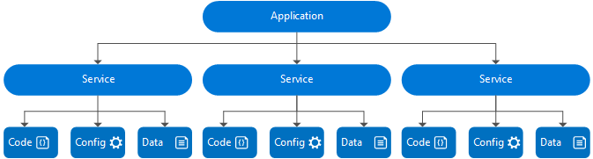
Application model

Slide 24
Programming model

Slide 25
Guest Executables
An arbitrary executable, written in any language, such as Node.js, Java, or native applications can be packaged in Azure Service Fabric and host it on a Service Fabric cluster.
Guest Executables are treated by Service Fabric like stateless services.
Service Fabric manages orchestration, manages execution of executable.
Does not benefit from full set of Service Fabric features.

Slide 26
Reliable Services
The Reliable Services framework is used for writing microservices using traditional .NET constructs.
Framework for writing services that integrate with Service Fabric platform.
Gives full control over design and implementation choices.
Services can be stateless or stateful Reliable Actors.

Slide 27
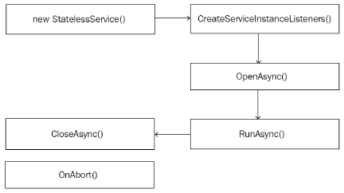
Stateless Reliable Service
A stateless microservice in Service Fabric does not contain any state data that needs to be stored reliably or made highly available.
There is no affinity of requests to the services, therefore stateless services store any state data in external store such as Azure SQL database or Redis cache.

Slide 28
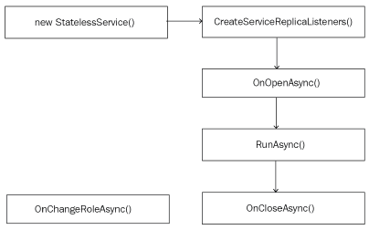
Stateful Reliable Service
A stateful microservice in Service Fabric can reliably maintain state that is co-located with the executing code of the microservice.
Service Fabric platform ensures that the state data is replicated, consistent and highly available.
Service Fabric application programming framework provides Reliable collection that can be used to store state data with reliability guarantees.

Slide 29
Stateful microservice
Application Package
replication
replication
replication
replication
S
S
P
S
S
P

Slide 30
Reliable Collections
Reliable collections make it easy to build stateful services.
An evolution of .NET collections for the cloud.
Collections
Single machine
Single threaded
Concurrent
Collections
Single machine
Multi threaded
Reliable Collections
Multi machine
Replicated (HA)
Persistence (durable)
Asynchronous
Transactional

Slide 31


Reliable Collections
IReliableDictionary<K,V>
IReliableQueue<T>
Data is replicated and durably stored on multiple replicas.
Atomically update one or more collections using transactions.
Supports LINQ.

Slide 32
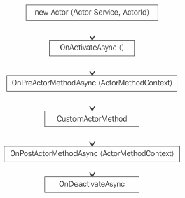
Reliable Actors
An independent unit of compute and state with large number of them executing in parallel
Communicates with other actors using asynchronous messaging
Has single threaded execution (turn based concurrency)

Slide 33
Create a Reliable Actor
Define Actor Interface
public interface IHelloWorld : IActor {
... }
Implement Actor Interface
public class HelloWorldActor : Actor, IHelloWorld {
... }
Register Actor Implementation with Runtime
using (var fabricRuntime = FabricRuntime.Create())
{
fabricRuntime.RegisterActor(typeof(HelloWorldActor));

Slide 34
3-tier Applications using Stateless Microservices

Slide 35






Stateless frontend and stateless middle-tier
Scale with partitioned storage
Increase reliability with queues
Reduce read latency with caches
Manage your own transactions for state consistency
Many moving parts each managed differently
Load Balancer
Front End
(Stateless
Web)
Stateless
Middle-tier
Compute
Cache
Queues Storage

Slide 36

Stateless frontend and stateful middle-tier
Application state lives in the compute tier
Low Latency reads and writes
Partitions are first class for scale-out
Built in transactions
Fewer moving parts
Load Balancer
Front End
(Stateless
Web)
Stateful
Middle-tier
Compute
data stores used for analytics and disaster recovery

Slide 37
References
Namit Tanasseri & Rahul Rai. Microservices with Azure. Birmingham – Mumbai : Packt Publishing, 2017.
https://www.packtpub.com/virtualization-and-cloud/microservices-azure
Gopal Kakivaya. Microsoft Azure Service Fabric Architecture. Microsoft Ignite, 2015.
http://video.ch9.ms/sessions/ignite/2015/decks/BRK3717_Kakivaya.pptx
Mark Fussell. Build always-on, hyper-scalable, microservice-based cloud applications. Microsoft Azure.
https://goo.gl/iTMefG

